Slide 1
Bots in the real world
Christopher Harrison
SDE, DX, Microsoft
@geektrainer

Slide 2
I'd like to search for a restaurant.
Sure thing! In what city did you want to search?
San Francisco
What type of cuisine?

Slide 3
Command Line
C:\
Tell me what to do
using a language you don’t know
P.S. I will delete all your files if you get even the tiniest detail wrong.

Slide 4
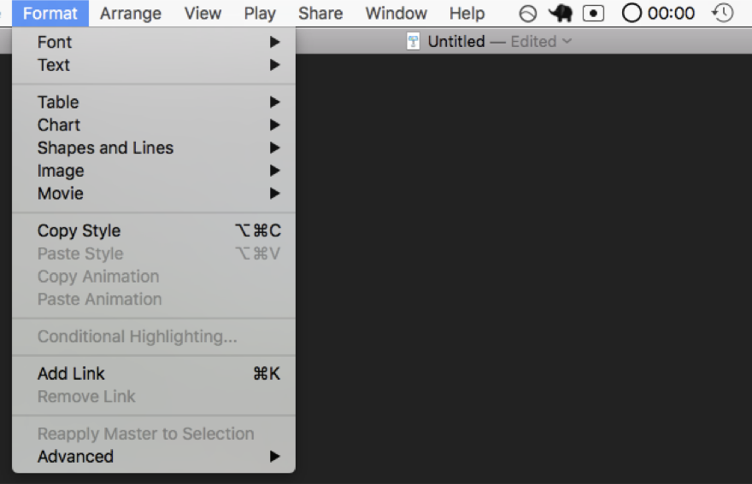
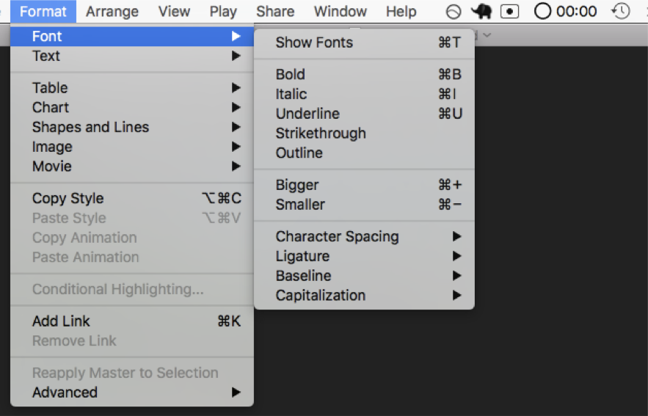
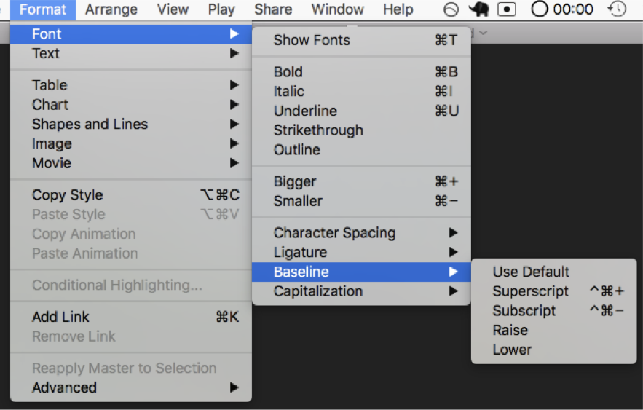
Menus
Select from the following options
So many options
Yo, I heard you liked options so here are some options for your options

Slide 5
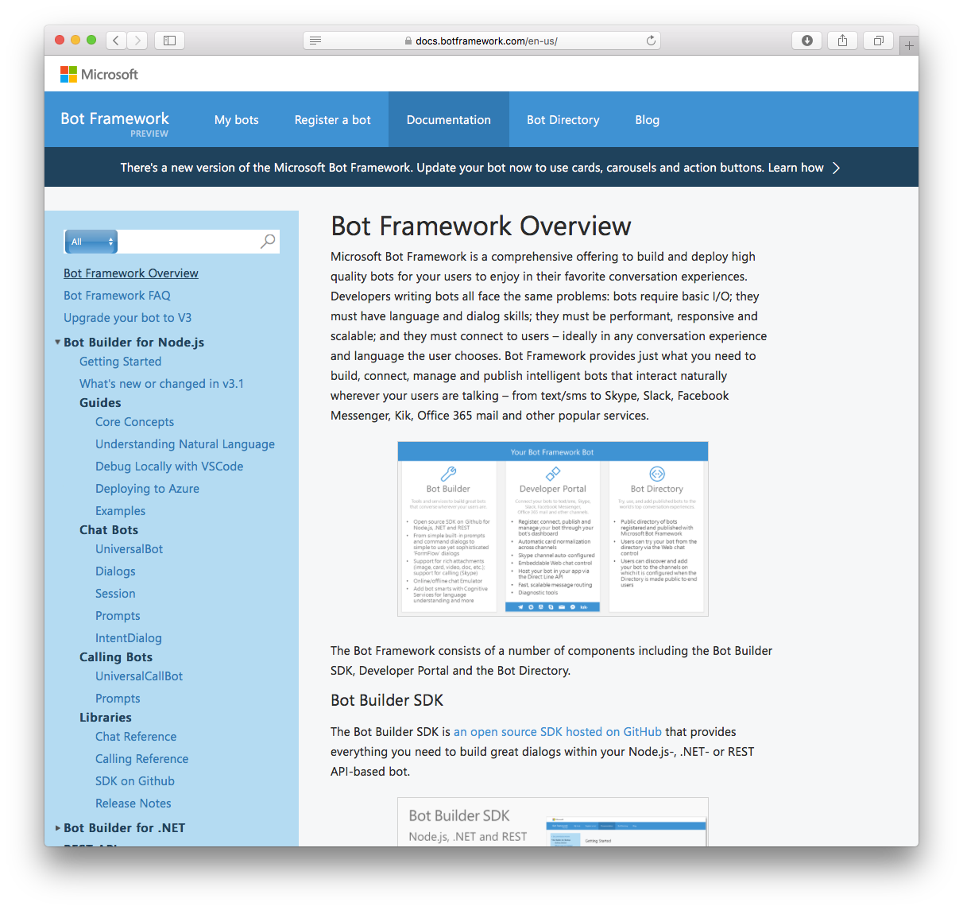
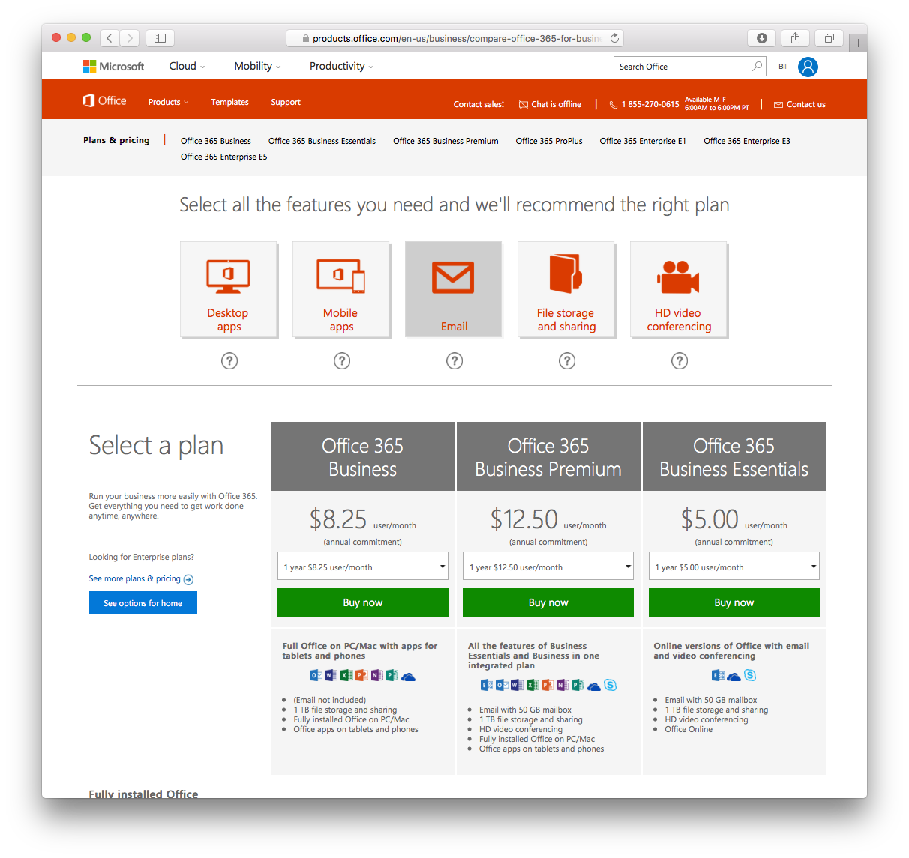
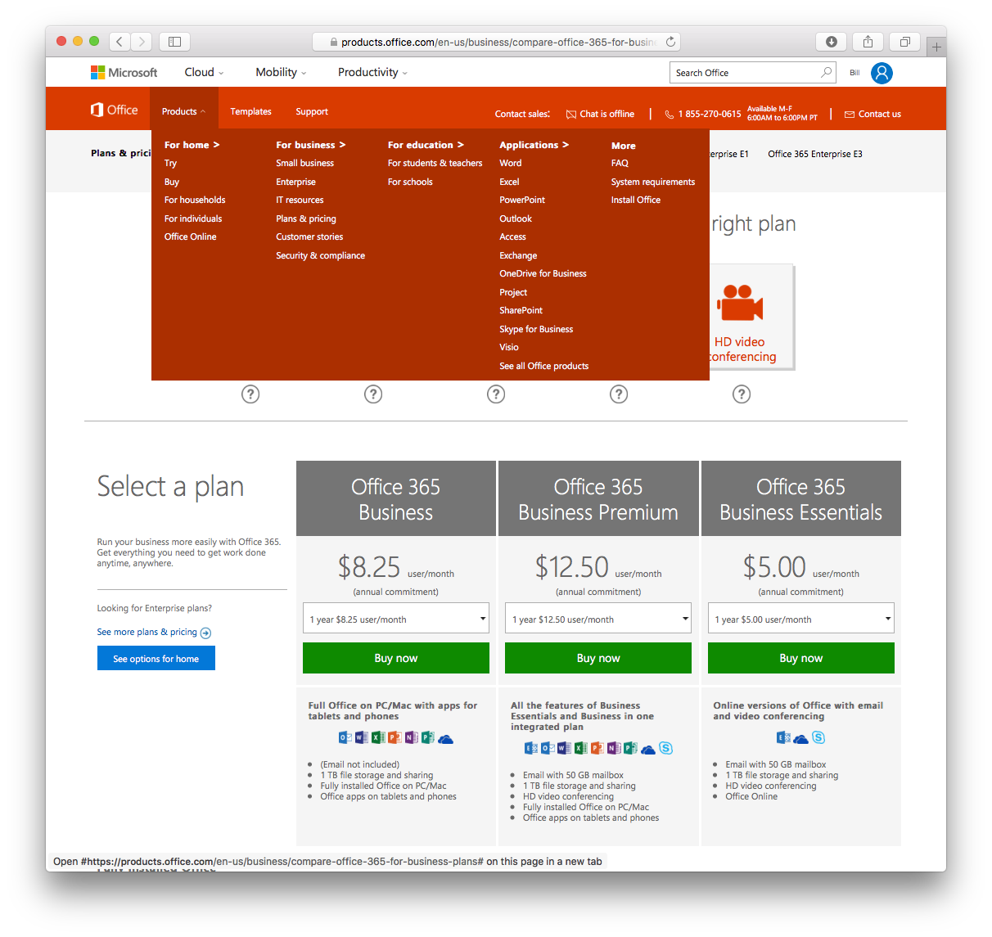
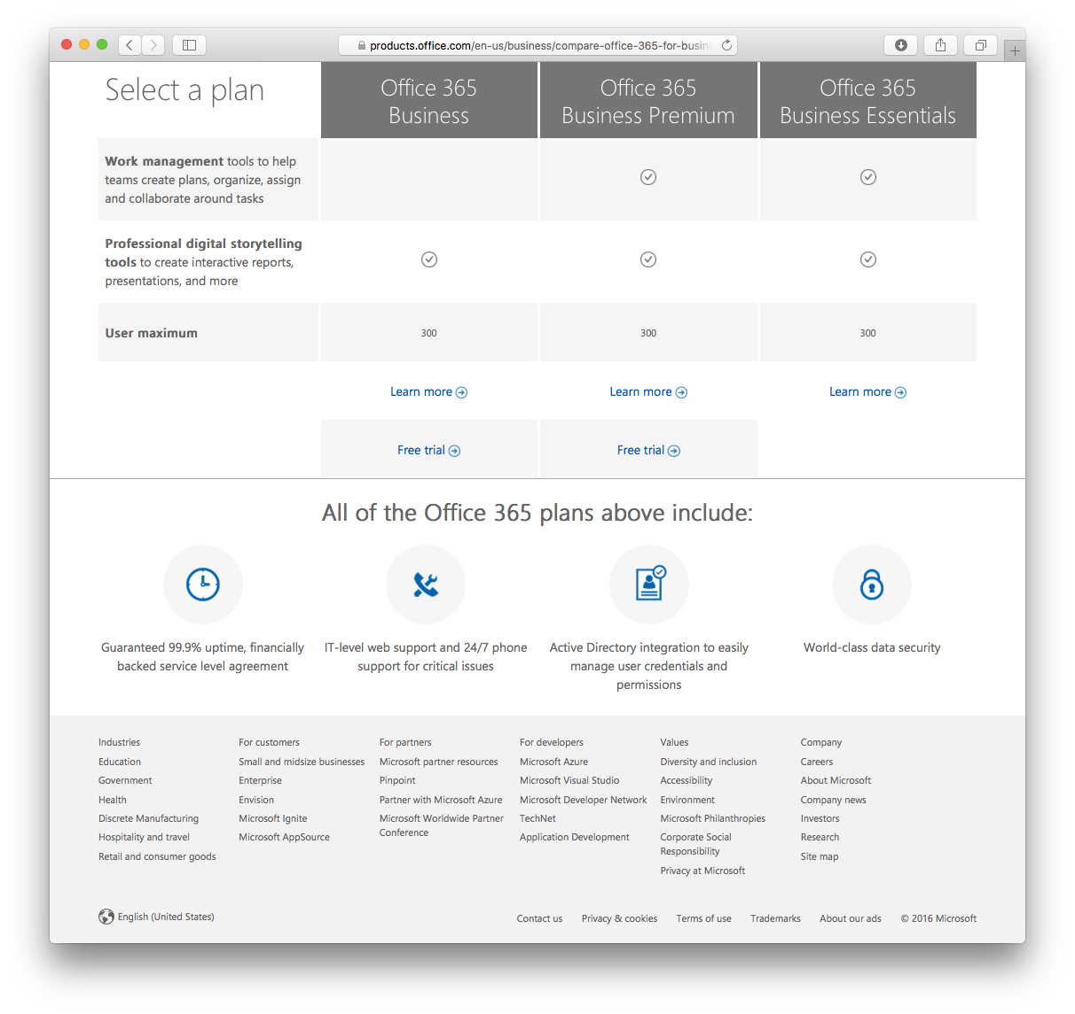
Websites
Good luck finding what you’re looking for.
Keep looking, it’s there somewhere.
Probably.
Start over again with the next website.

Slide 7
IT’S YOUR JOB TO FIGURE OUT THE COMPUTER
LET’S MAKE
THE COMPUTER FIGURE OUT YOU
THE COMPUTER

Slide 8
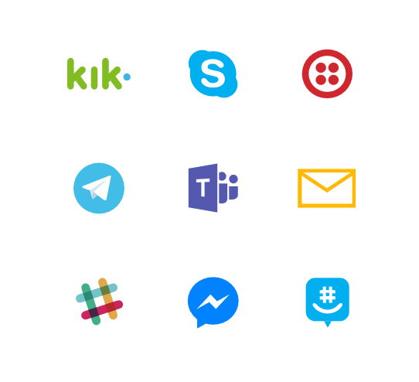
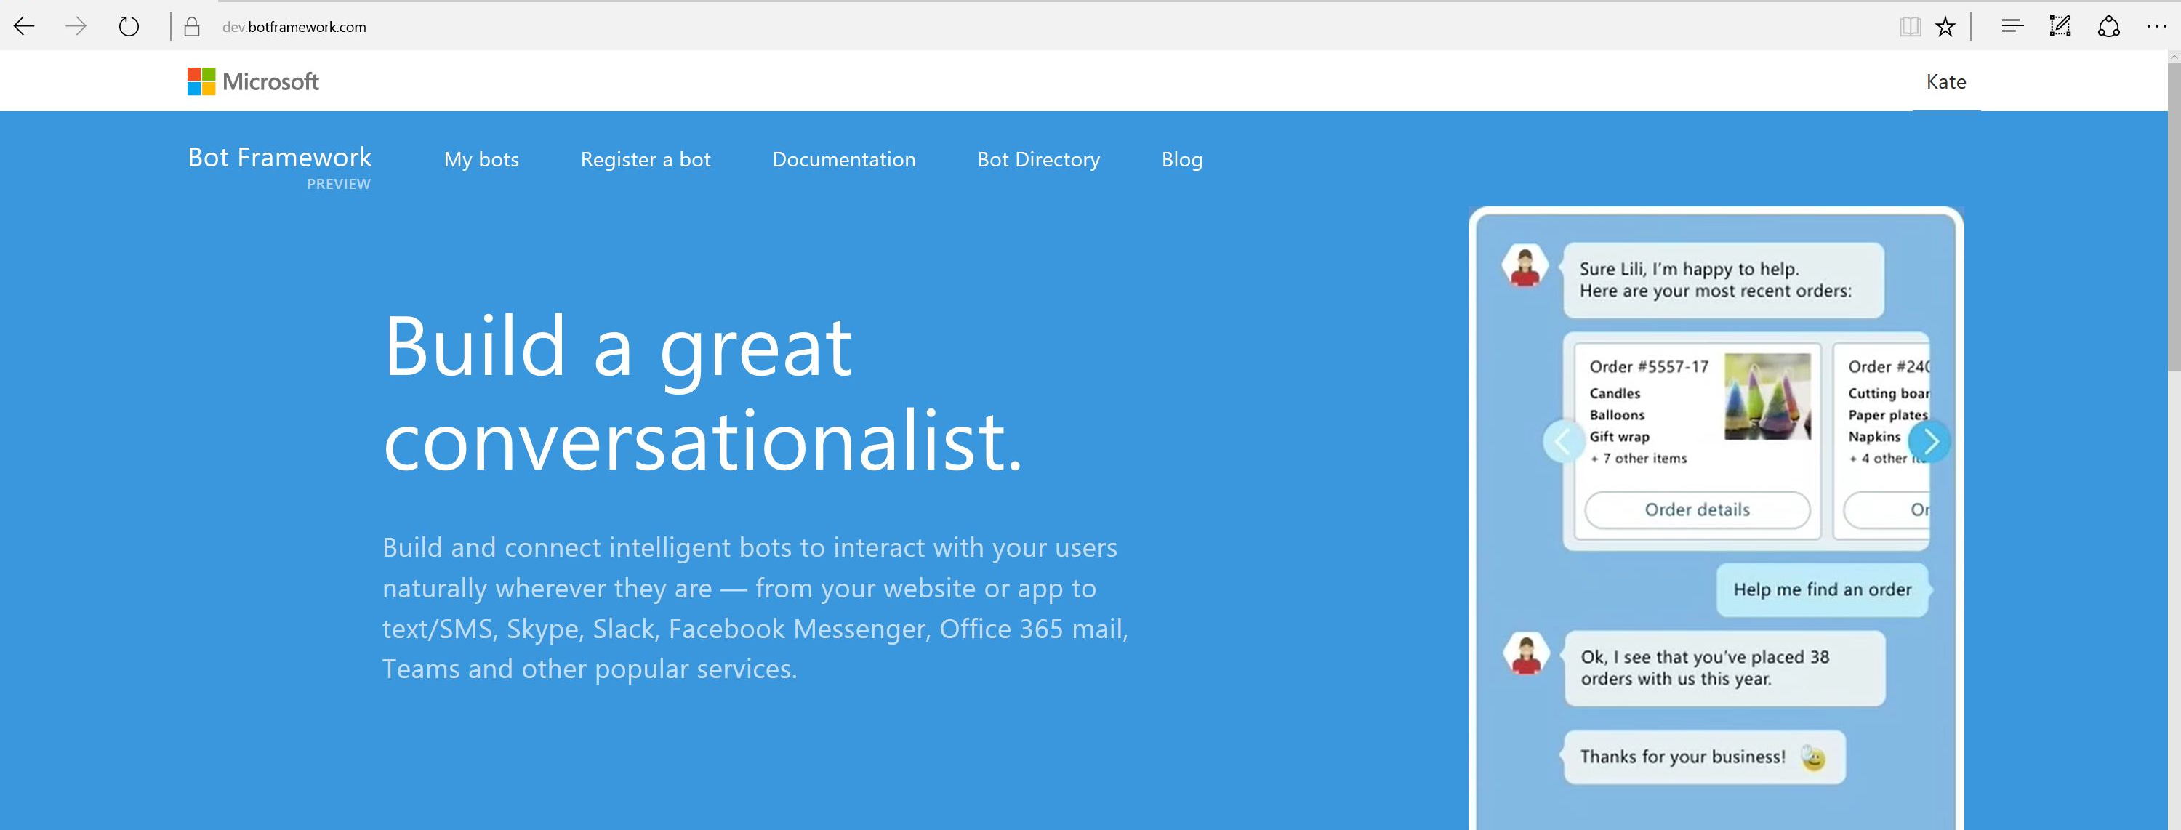
Bot Framework

Slide 9
What is a bot?
Notes:
Given all that, what is a bot?

Slide 10
A bot is an app

Slide 11
Similar design, different paradigm
Traditional Application
Bot
Main Screen
Root Dialog
New Order Screen
Product Search Screen
New Order Dialog
Product Search Dialog

Slide 12
Project Murphy
Notes:
Demo:
Project Murphy

Slide 13
An x-ray of a typical bot
Conversation Canvas/Channels
Your bot code goes here
Web Chat
Bot Connector Service
Email
Message input <> output
State Management
Facebook
Bot web service
GroupMe
Your bot code
Bot Builder SDK
Kik
Skype
Bot Builder SDK
API, SDK calls
Slack
+ Microsoft Cognitive Services
Telegram
Other services, APIs,
Databases, Azure Machine Learning, Azure Search, etc…
Natural Language
Translation
Vision/Face
Emotion
Twilio (SMS)
…
Direct Line…
Speech
Entity Extraction
Search
Knowledge API
…
…
…

Slide 14
A bot is an app with a little more humanity
Notes:
In short, a bot is just a type of app. One that connects to users at a slightly more personal level.

Slide 15
But... Do you really need a bot?

Slide 16
Bots don’t inherently solve all problems
Address your core issues first
Determine if a different type of app might be appropriate
How will this be different from your existing website

Slide 17
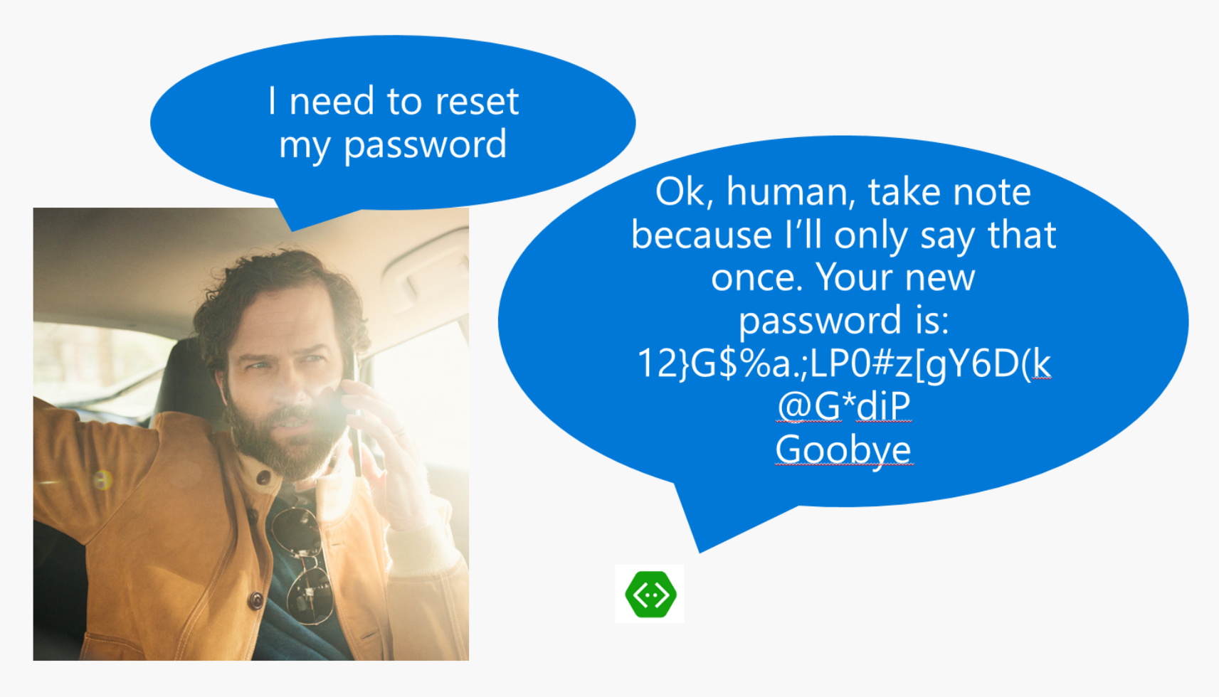
Anti-pattern: Canvas/input mismatch

Slide 18
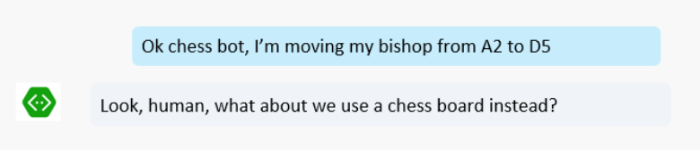
Anti-pattern: Canvas/input mismatch

Slide 19
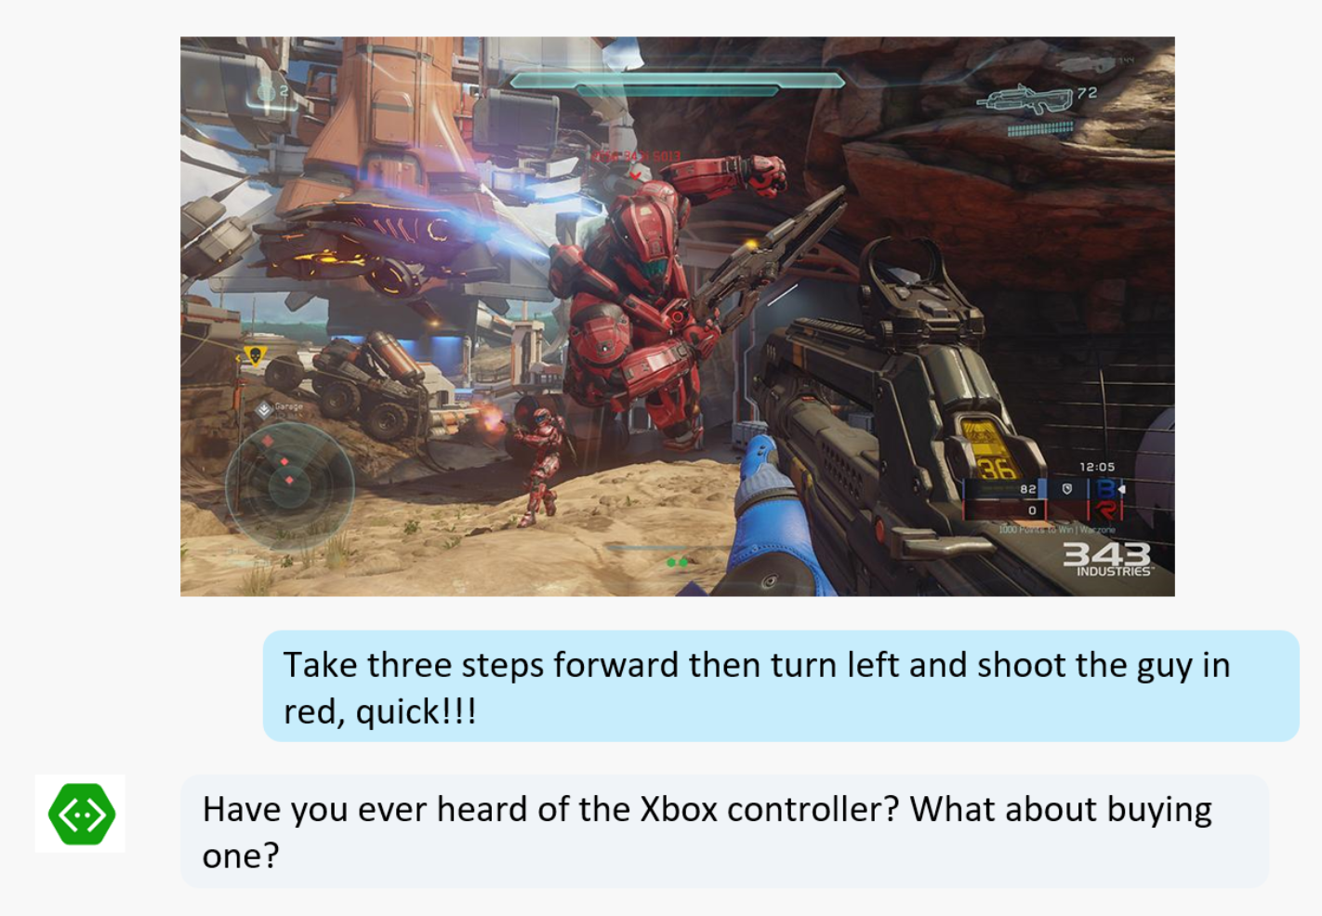
Anti-pattern: Canvas/input mismatch

Slide 20
Using the right interface

Slide 21
Common patterns

Slide 22
Knowledge Base Bots
Bots that can reason over a corpus of data to find and return a piece of information
Event bots, Help Desk bots, Contact bots, etc.
#MSBuild

Slide 23
Handoff to Human
Every company deals with this:
First triage/data collection
Simple and repetitive solutions
Customer call
Complex cases and escalation

Slide 24
Backchannel
Backchannel is the practice of using maintaining a real-time online conversation alongside the primary group activity or live spoken remarks

Slide 25
The labs

Slide 26
Introducing the labs
All based on real world scenarios
Blend of guided experience and hackfest
Each lab contains
Step by step instructions
If you feel unsure about what to do
Detailed user stories
High-level steps
Further challenges
Take your bot to the next level

